Slide 1


Slide 2

IDEA OVERVIEW
A User-friendly web-based Greenhouse gas footprint calculator predicts an individual's environmental impact, providing a detailed result that quantifies their contribution to climate change. It offers personalized suggestions for reducing this impact, from conserving energy and adopting eco-friendly transportation, diet, energy consumption to minimize climate damage and suggesting alternatives for them. And our website will also display damage caused by them. Alternatively, without such tools, people may remain unaware of their environmental footprint, potentially leading to increased emissions, resource depletion, and ecosystem damage.

Slide 3

MARKET PROSPECTS
User-Centric Design: Prioritize user experience and user-friendly interfaces. Make data input and results presentation user-friendly to encourage engagement.
Data Accuracy: Ensure precise emissions calculations and transparent data sources.
Education: Provide informative content on climate change and tree planting.
Personalized recommendations: Provide users with actionable, personalized recommendations for reducing their carbon footprint and supporting reforestation efforts.
Community Building: Create a platform for users to share experiences and tips.
Impact Tracking: Enable users to monitor their environmental progress.
Partnerships: Collaborate with eco-friendly organizations and influencers.
Mobile Accessibility: Optimize for mobile devices and consider a mobile app.
Data Security: Emphasize user data protection and privacy.
Marketing and Feedback: Promote through digital marketing, gather user feedback, and iterate based on insights for sustained growth and impact.

Slide 4

FUTURE SCOPE
Personalized Action Plans: Provide users with personalized recommendations on how they can reduce their greenhouse gas footprint based on their individual lifestyle and habits.
Integration with Smart Devices: Connect the calculator to smart devices like thermostats and electric vehicle chargers to track and reduce energy consumption automatically.
Education and Awareness: Include educational content on climate change, greenhouse gases, and the importance of reforestation to raise awareness and inspire action.
Community Forums: Create a community forum where users can share their experiences, tips, and success stories in reducing their carbon footprint.
Mobile App: Develop a mobile app version for on-the-go tracking and access to environmental data.
Carbon Tracking and Reporting: Offer users the ability to track their emissions over time, generate reports, and set long-term sustainability goals.

Slide 5

TECHNICAL OVERVIEW
Frontend Development :
User Interface (UI) : Design an intuitive and user- friendly interface for users to input data and access results.
Web Technologies : Use HTML, CSS, and JavaScript for frontend development.
Data Visualization : Implement charts and graphs to display carbon footprint data and deforestation information.
Backend Development :
Server : Set up a web server (e.g., Apache, Nginx) to host the website.
Programming Language : Choose a backend programming language (e.g., Python, Node.js, Ruby) for server-side logic.
Database : Set up a database to store user profiles, calculation data, and other relevant information. A relational database (e.g., MySQL, PostgreSQL) or a NoSQL database (e.g., MongoDB) could be used.
Calculator and Screening Algorithms :
Develop algorithms to calculate users' greenhouse gas footprints based on input data (e.g., transportation, energy usage, diet) and deforestation screening criteria. - Ensure accuracy by using up-to-date emission factors and deforestation data.

Slide 6
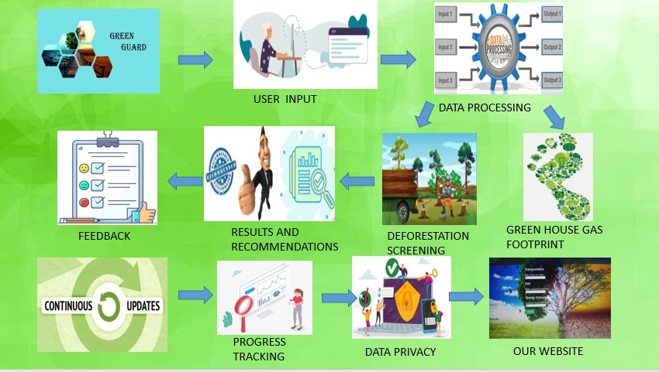

Slide 7

EXECUTION
Users input data on their activities, such as transportation (car usage, bike usage)and energy consumption(electricity usage), dietary choices and geographical location.
The system processes this data to calculate their greenhouse gas footprint.
It also assesses deforestation risks based on user geographical location and other factors.
Users receive results and personalized recommendations for reducing their footprint. These results are present in a user-friendly format such as graphs or charts to enhance understanding.
The platform engages users with tracking, goal-setting, and achievements.
Data privacy is maintained, ensuring user information is secure.
The platform measures the collective environmental impact of users.
Continuous updates keep the platform current with environmental trends.
The project educates users on climate change and create awareness among them.

